Slide 1
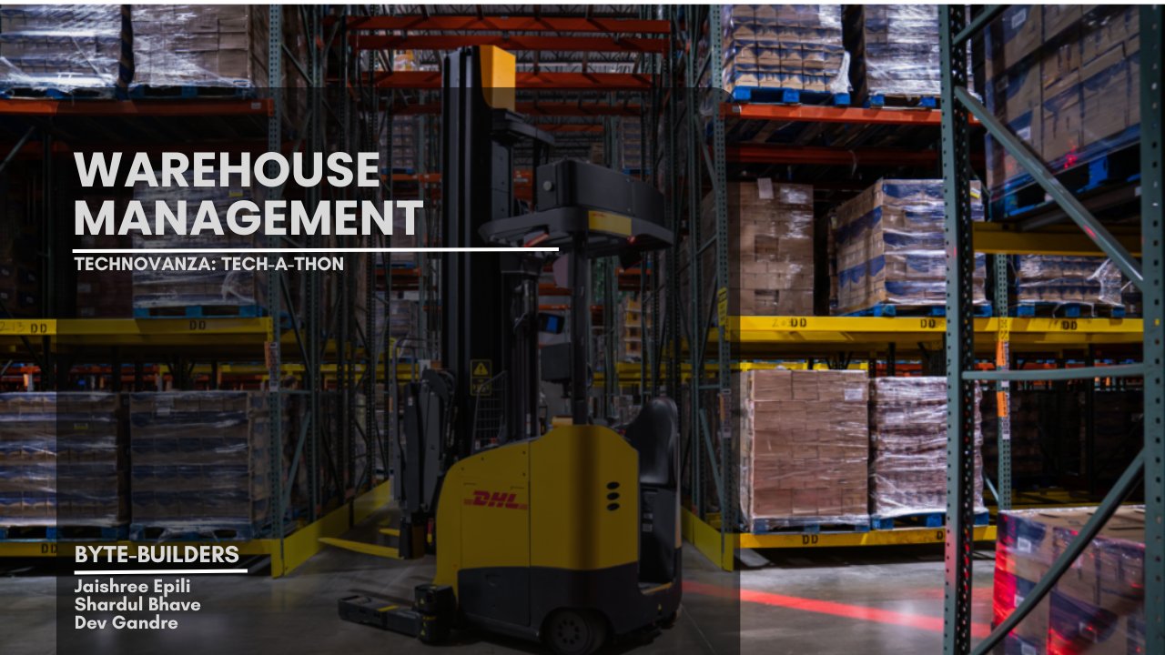

Slide 2
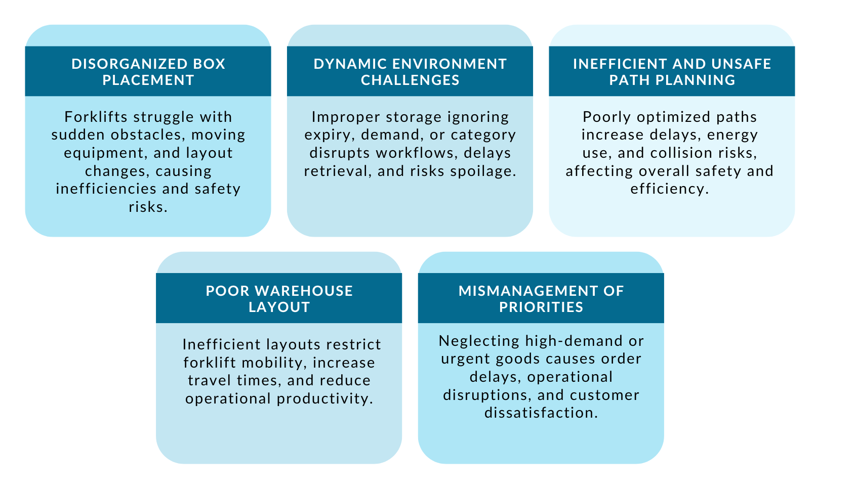
UNDERSTANDING THE PROBLEM STATEMENT
Where does the problem lie?

Slide 3
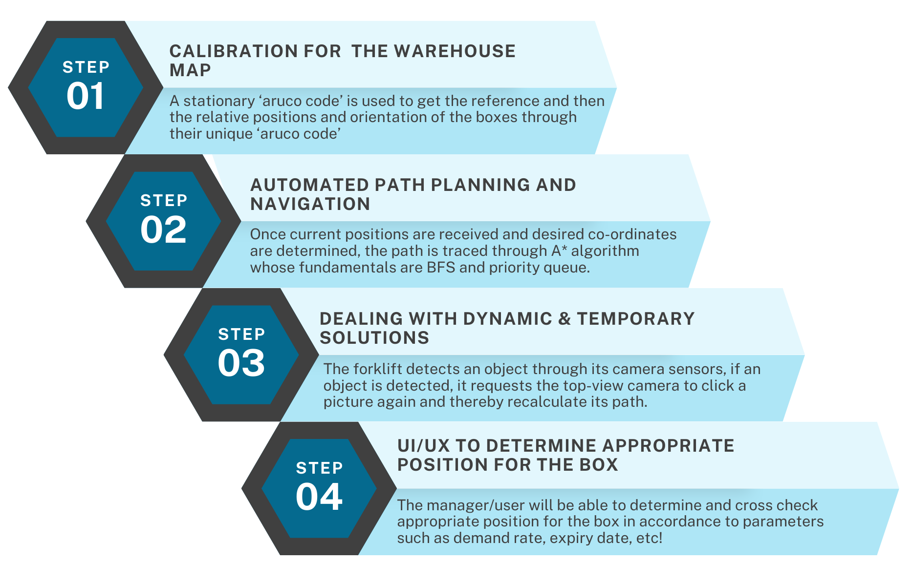
OUR PROPOSED UNIQUE SOLUTION
What marks the difference in our solution?

Slide 4
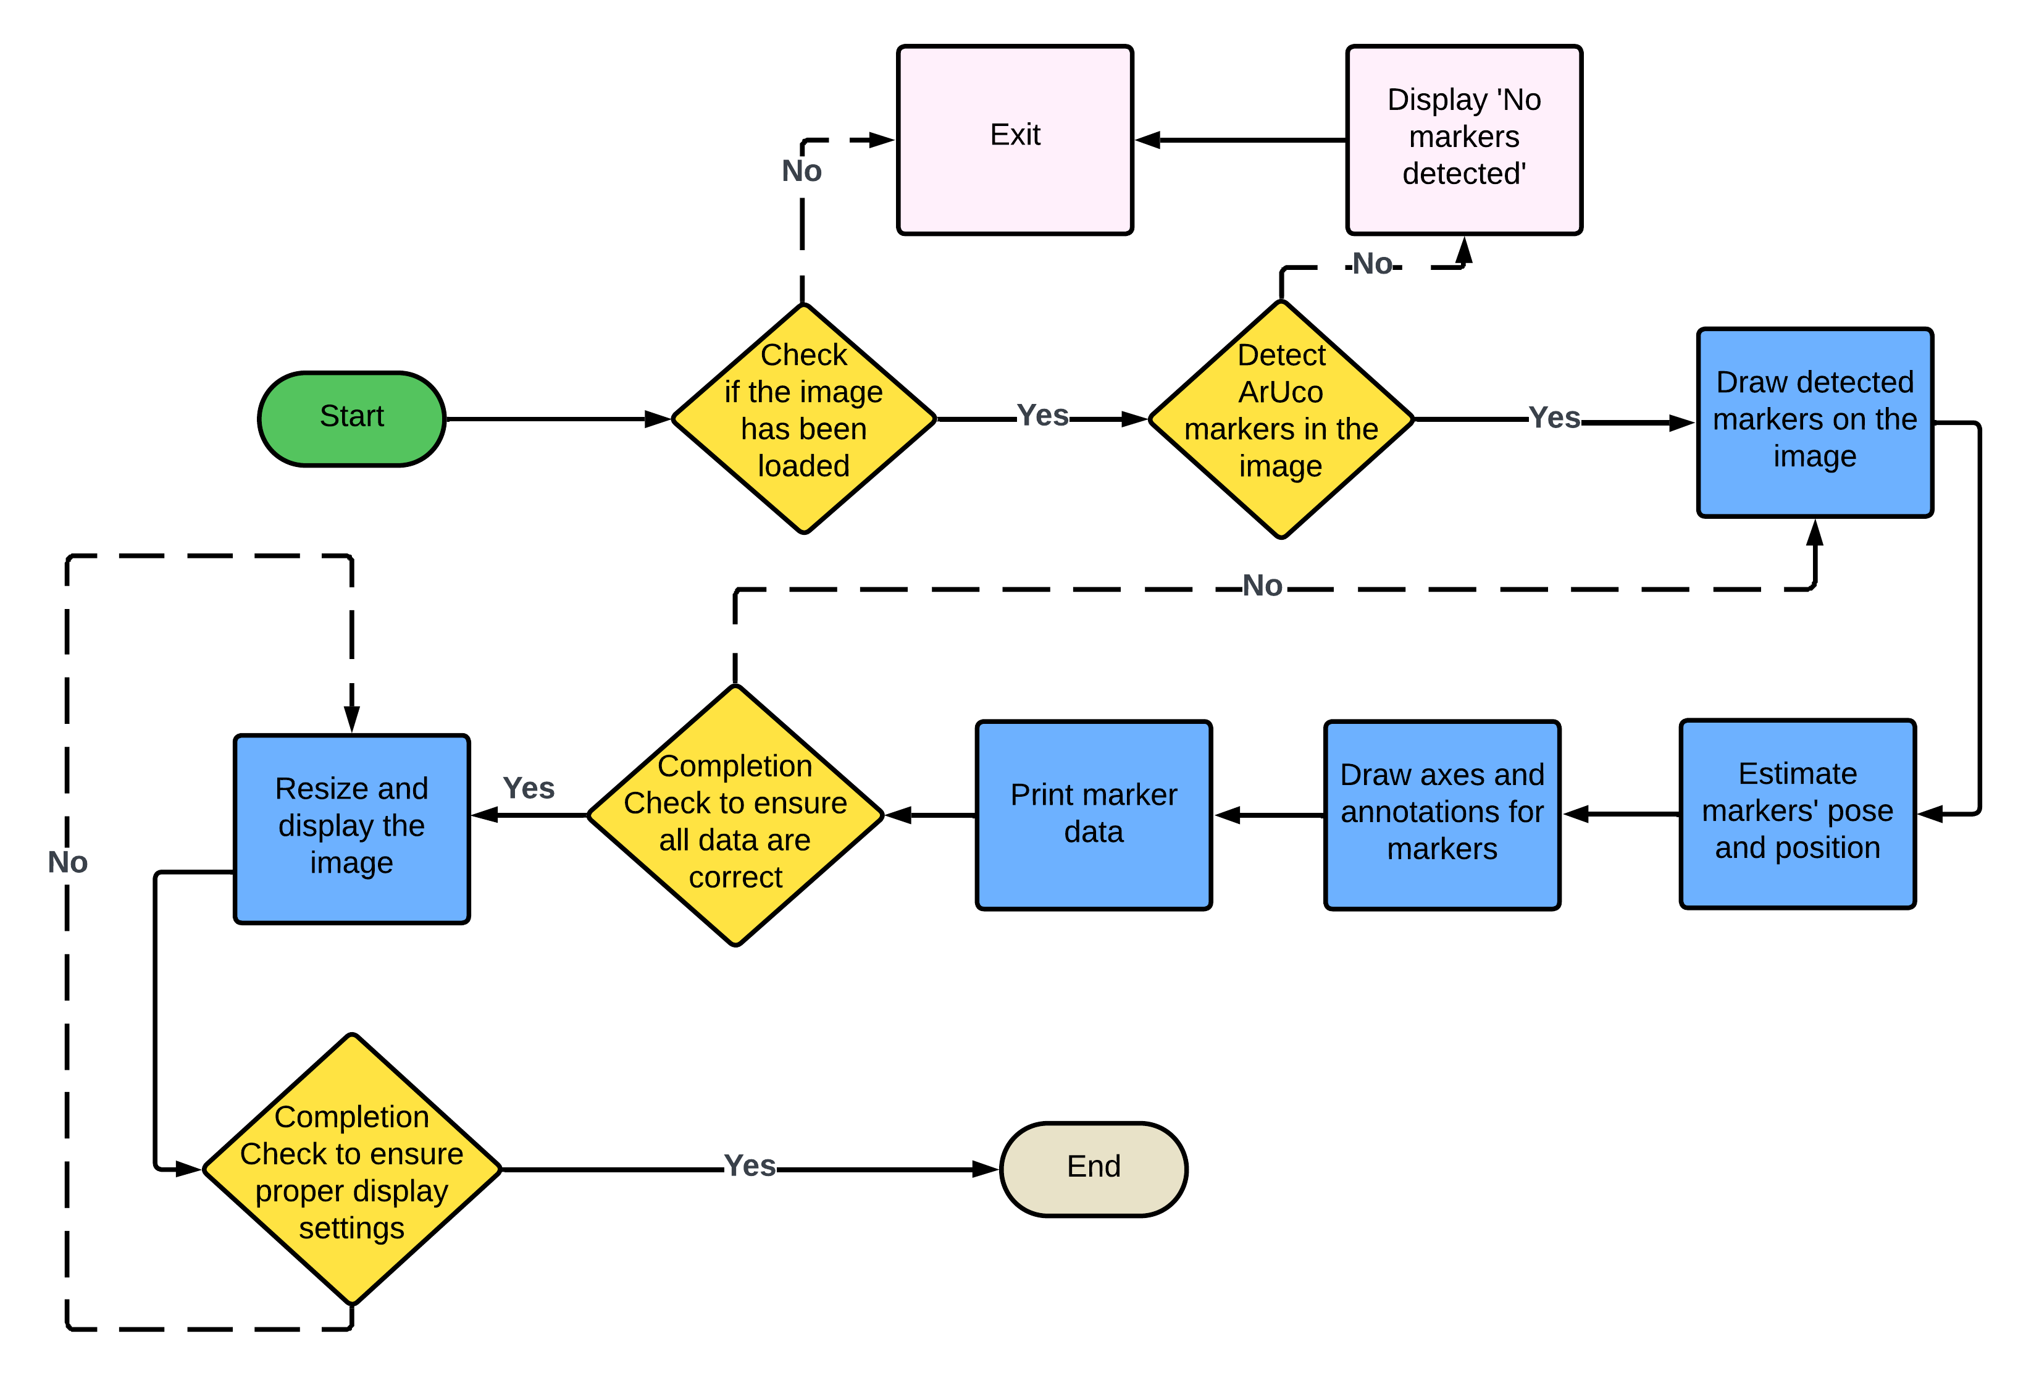
TARGETTING TASK 1
How did we solve the task at hand?
Flowchart to detect Arucodes, thereby determining position, orientation and number of boxes

Slide 5
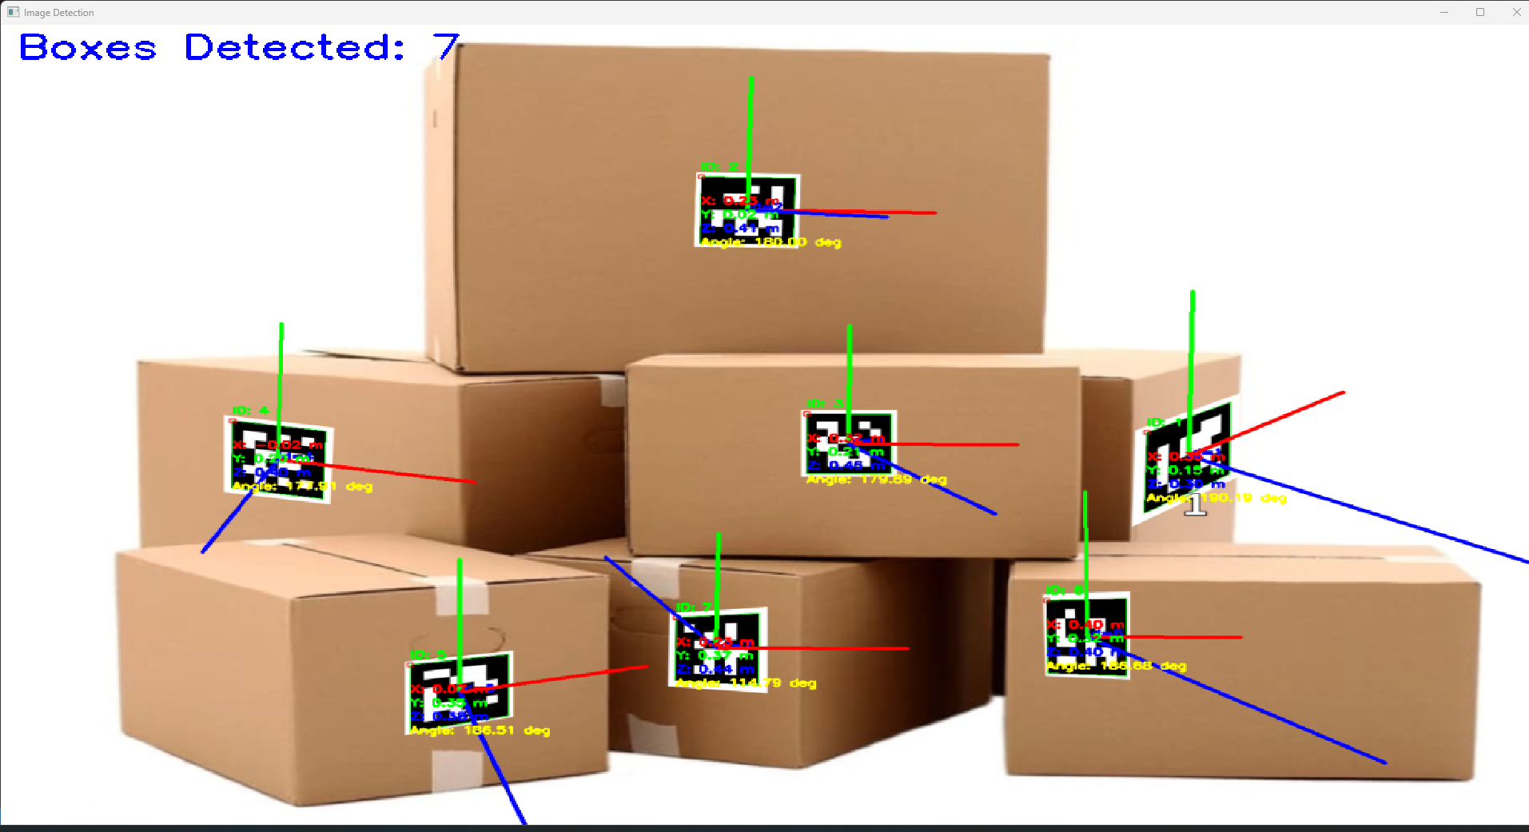
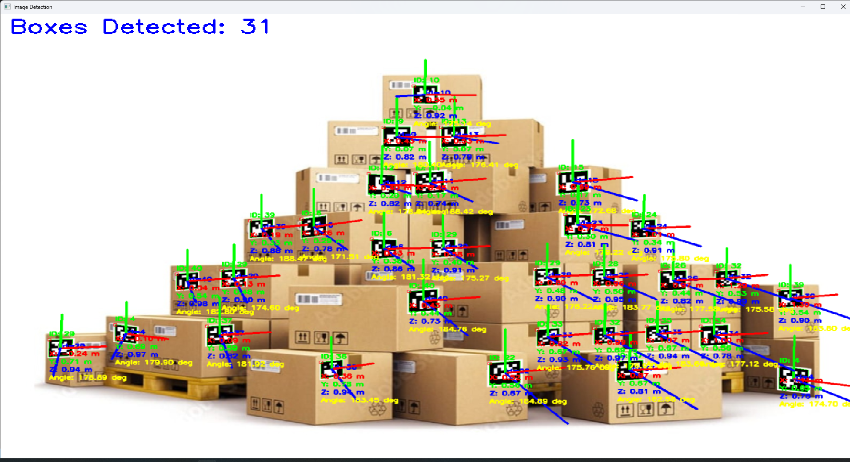
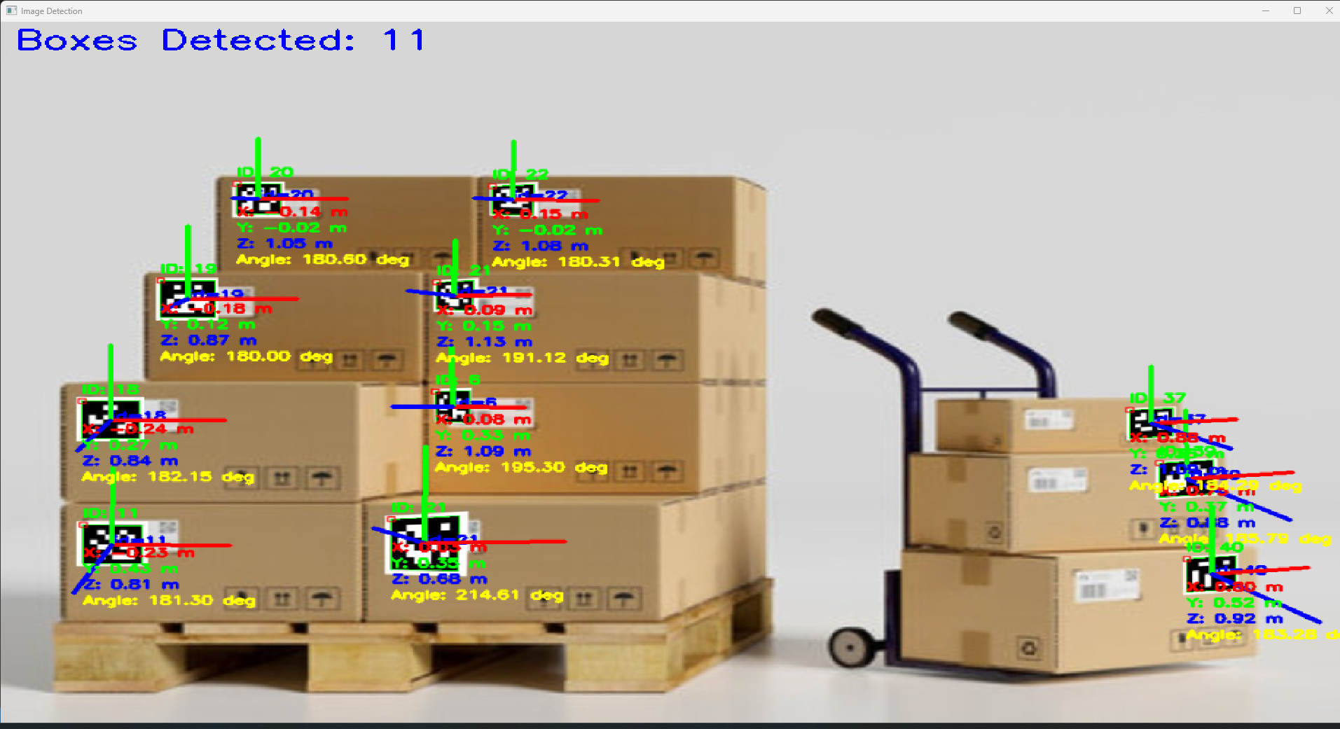
OUTPUTS OF TASK 1

Slide 6
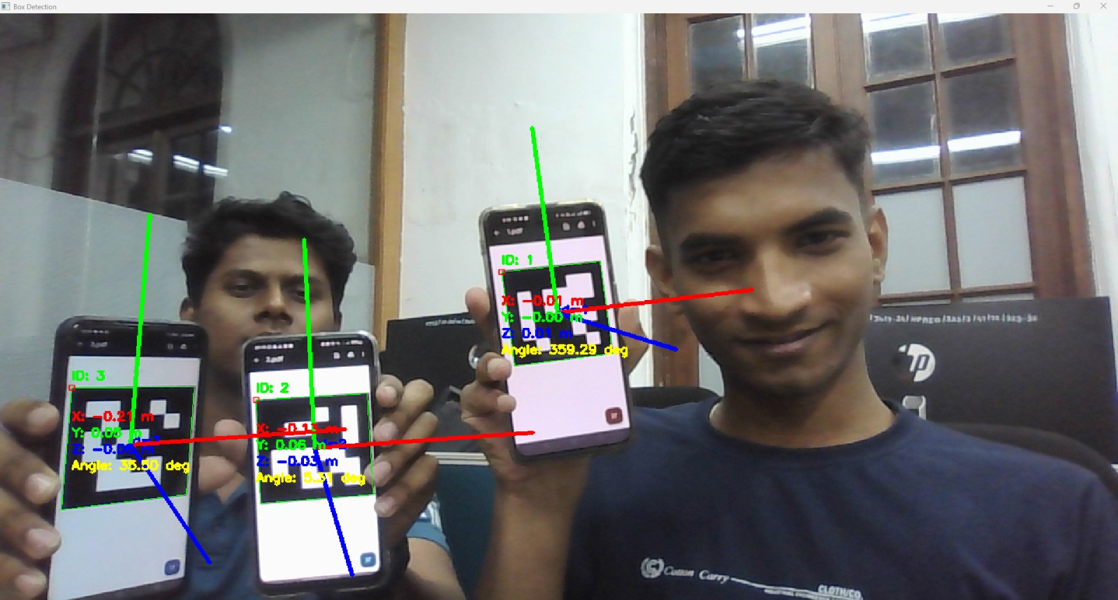
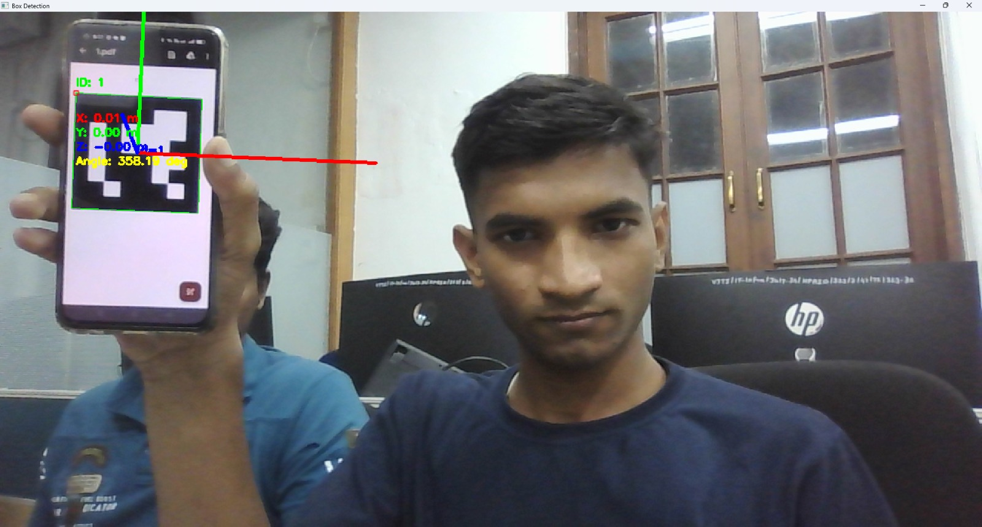
CORRELATING TASK 1 SOLUTION IN REAL WORLD
How do we solve the problem practically?
Calibration(i.e. setting reference) through Arucode
Now, all Arucodes further would have their positions and orientations calculated in accordance to reference

Slide 7
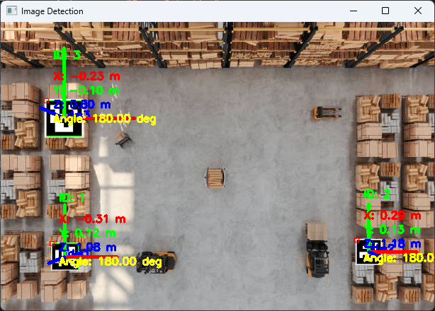
CORRELATING TASK 1 SOLUTION IN REAL WORLD
How do we solve the problem practically?
Arucodes being detected from the top of the boxes.

Slide 8
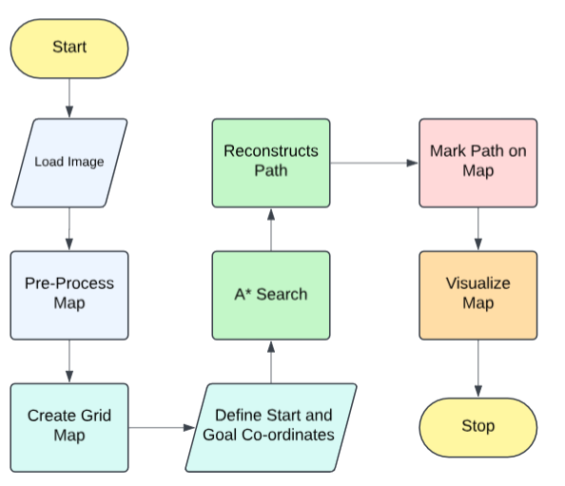
TARGETTING TASK 2
How did we solve the task at hand?
Flowchart for tracing a path from current position to goal position.

Slide 9
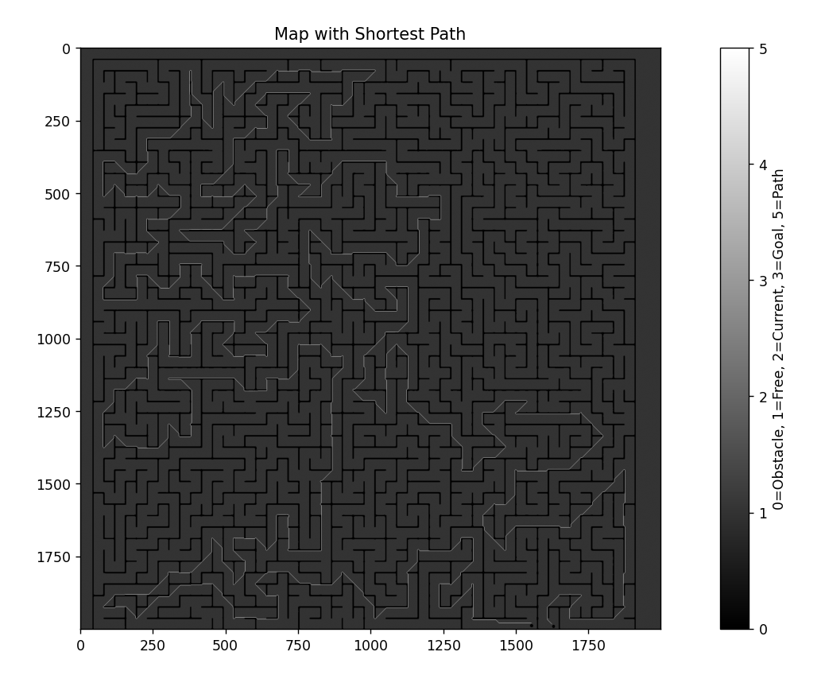
OUTPUTS OF TASK 2

Slide 10
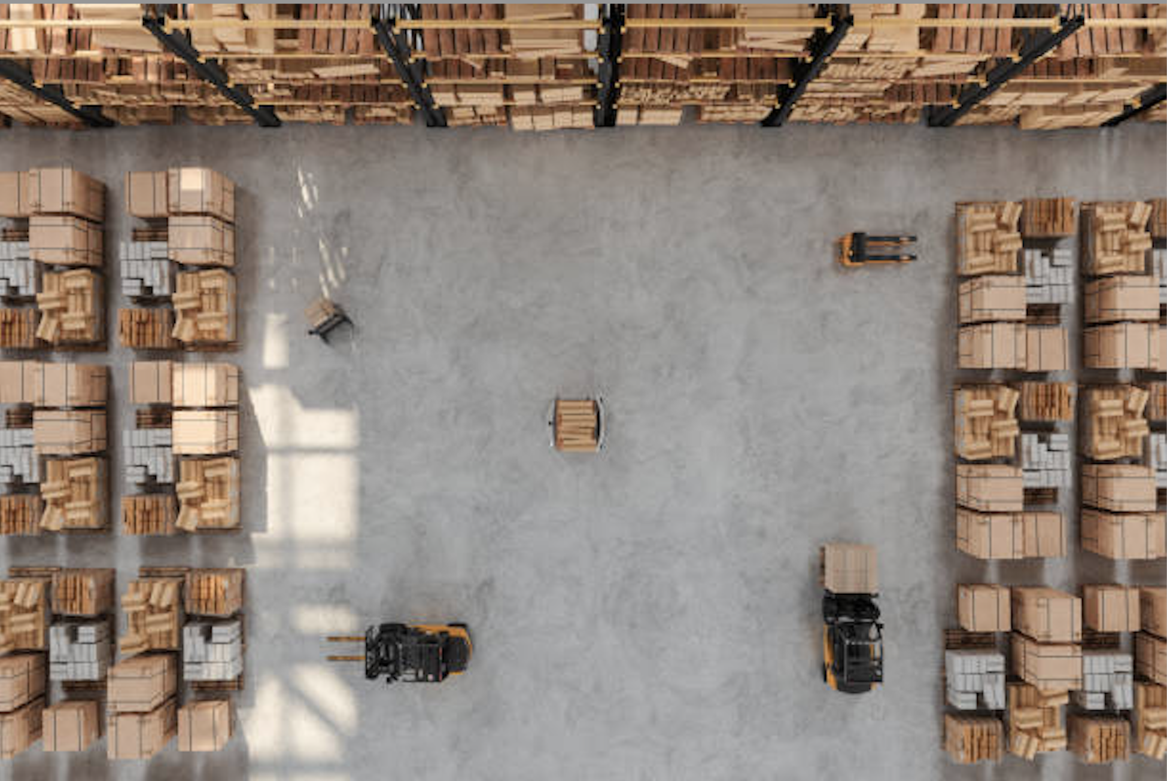
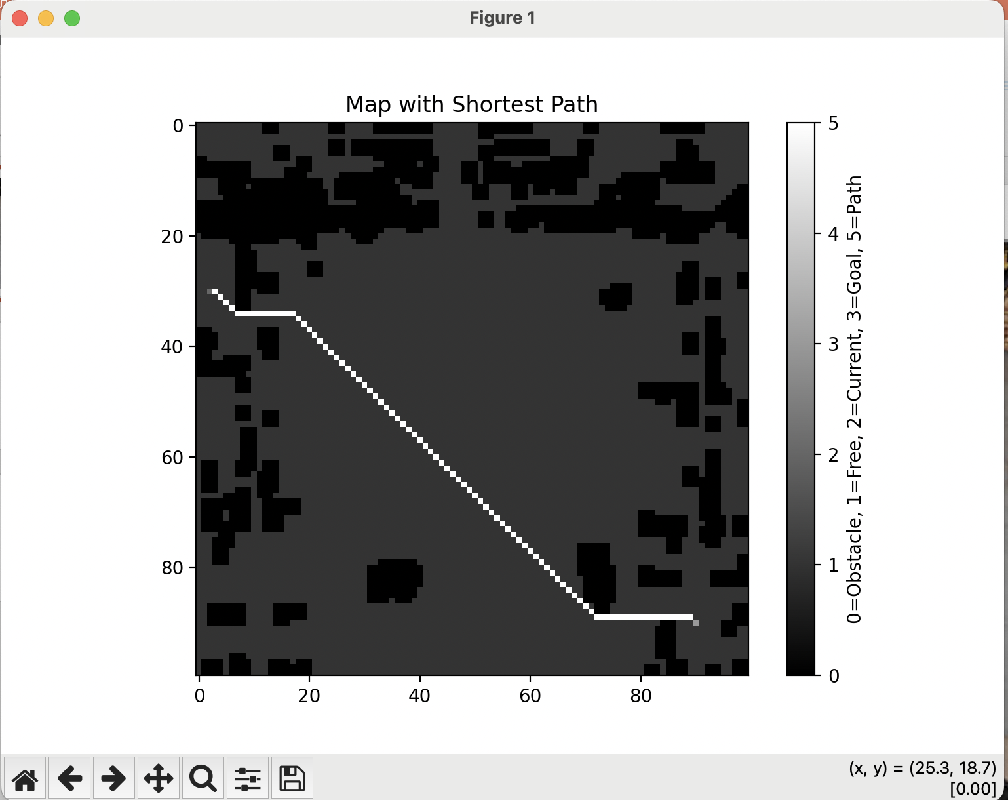
CORRELATING TASK 2 SOLUTION IN REAL WORLD
How do we solve the problem practically?

Slide 11
